Slide 1
Carbon Usage of Commuters
Transportation and Mobility | Team 1

Slide 2
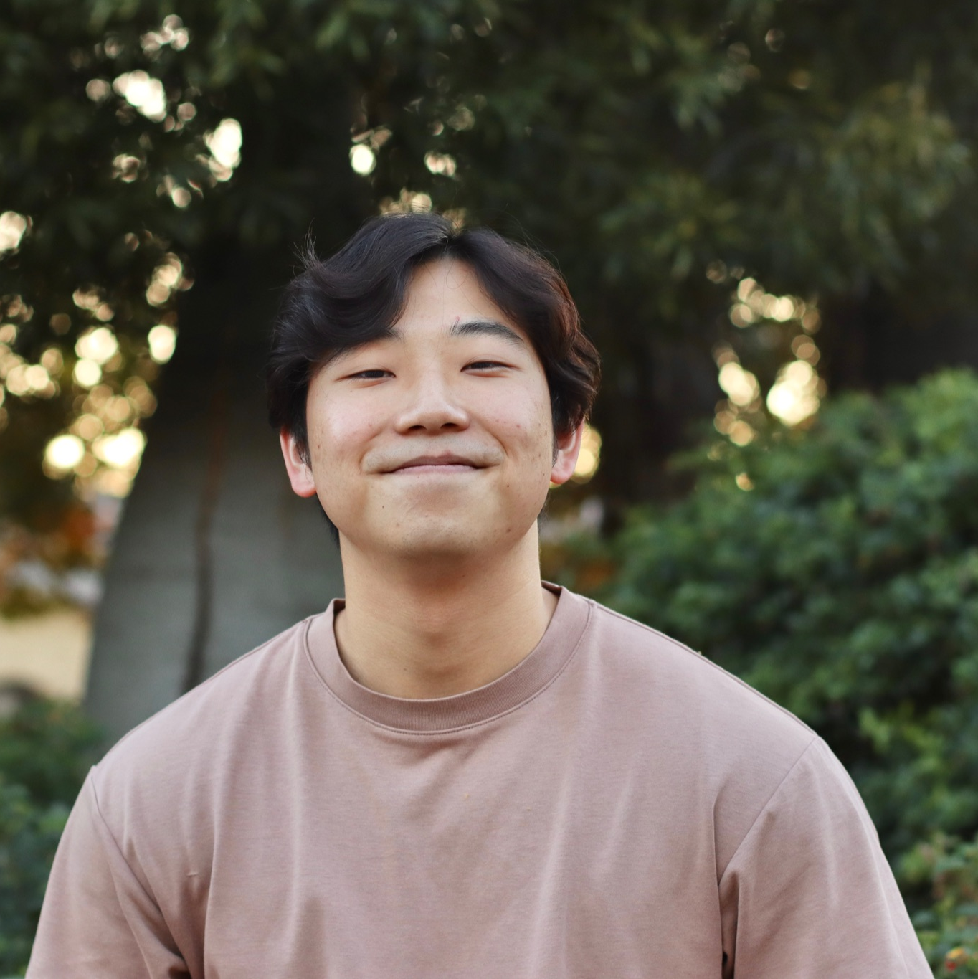
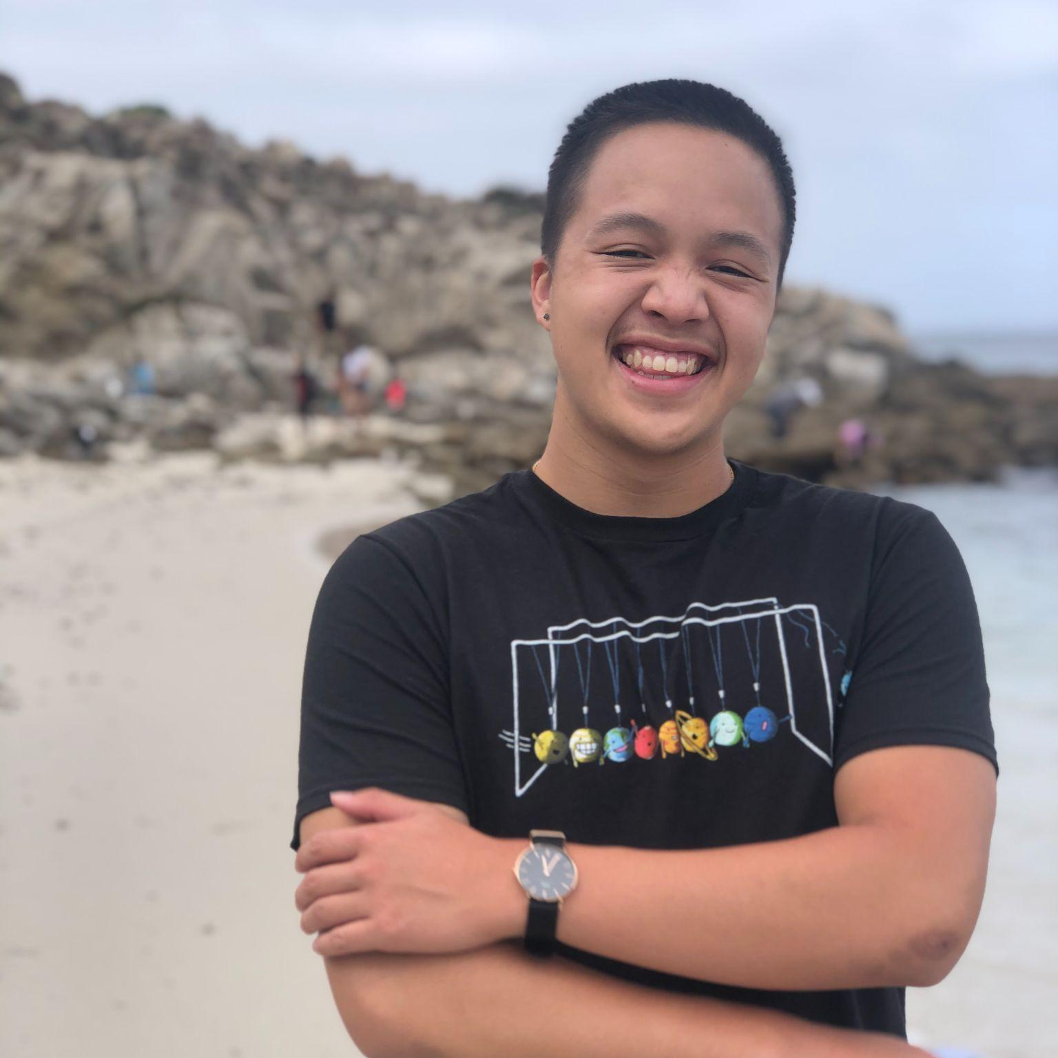

Our Team
Jiwon L.
Senior
CS
Houston, TX
Adi S.
Senior
CS
Scottsdale, AZ
Victor L.
Senior
SymSys
Sacramento, CA
Jack C.
Senior
CS
Boca Raton, FL

Slide 3
Needfinding Methodology

Slide 4
Our Interviewees
Who? People who commute to work
Why? Interested in their environmental consciousness and carbon usage
How? Connections on LinkedIn, work connections of friends
Where? Over Zoom, phone/FaceTime, in-person

Slide 5
Guiding Questions — What Did We Ask?
Tell me about your commute.
Tell me about a good or bad experience you’ve had during a commute.
What do you think of sustainability?
What do you think of your own carbon footprint?
What would make you care more about your carbon footprint?

Slide 6
Interview Results

Slide 7

Mike (24)
“Our culture doesn’t really acknowledge carbon usage.”
Insight
There is no clear education around carbon usage in transport, and communal pressures don’t dissuade usage.
Need: A better way to measure and evaluate carbon usage.
Associate at Private Equity Firm in Palo Alto
Lives in SF
Drives a gasoline car
40 min phone interview

Slide 8

Peter (24)
“If we are living in shared community, everyone should share resources and be aware of the costs.”
Insight
People care about their own consumption of a shared resource.
Need: To measure individual contribution to a shared waste of resources.
Analyst at Hedge Fund in Palo Alto
Lives in Mountain View
Drives an EV
25 min phone Interview

Slide 9
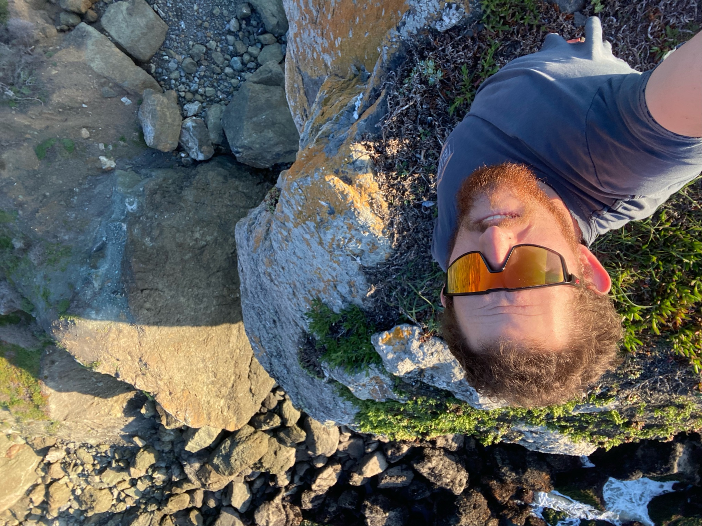
James (23)
“Having metrics would make me more aware of my habits and their impact from an emission standpoint.”
Insight
There is a general lack of awareness of the environmental impact of everyday activities.
Need: An accessible way of knowing the carbon usage metrics of certain activities.
Engineer at Apple
Lives in SF
Commutes via shuttle
20 min Zoom interview

Slide 10
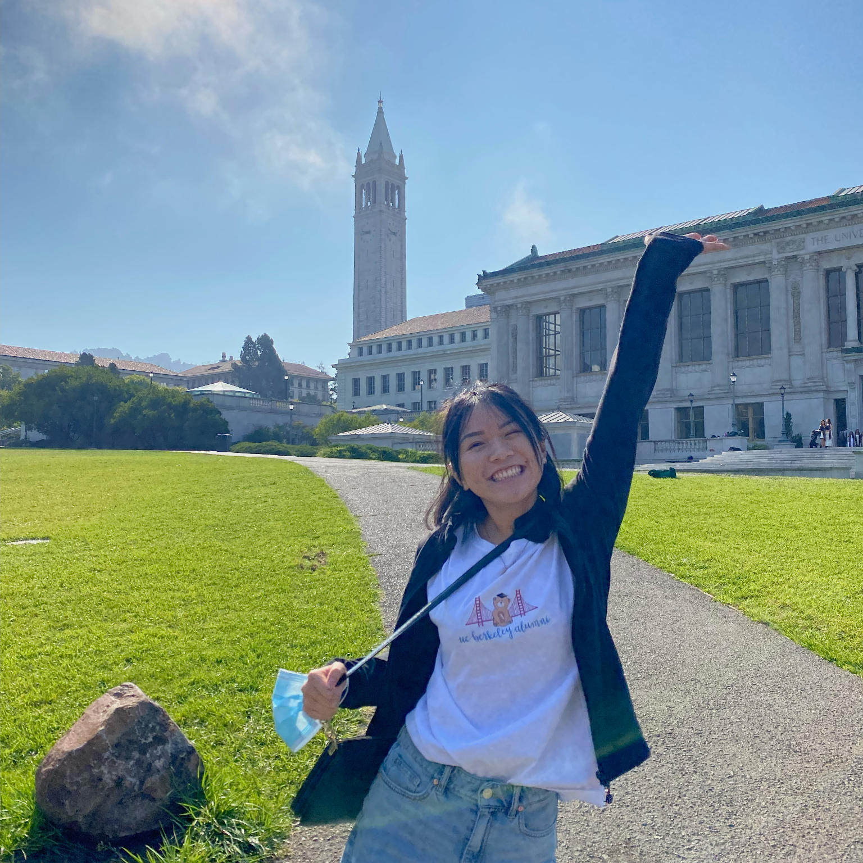
Winter (22)
“I think about sustainability in terms of food waste, recycling, and separating trash… but commuting not so much.”
Insight
Sustainability is not easily thought of in terms of commuting and transportation.
Need: More clarity on how transportation and daily commutes impact sustainability.
Medical Research Assistant
Lives in Mountain View
Drives a Prius
20 min Zoom interview

Slide 11
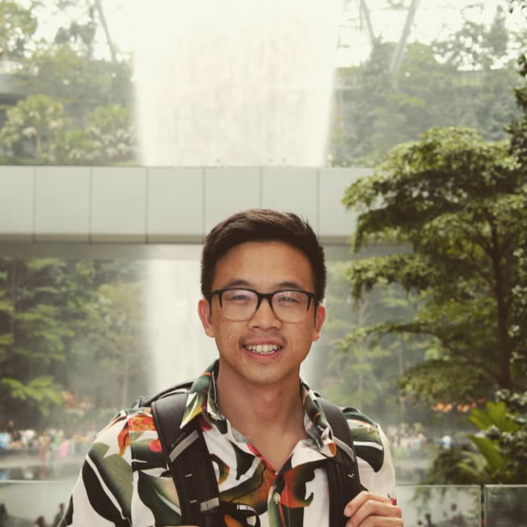
Ben (28)
“I don’t constantly think about my carbon usage and my carbon footprint everyday, but I know taking the train helps.”
Insight
Awareness and clarity of one’s carbon footprint can be crucial in regulating carbon use.
Need: A way to make thinking about one’s carbon footprint an easier and more consistent action throughout the day.
Social Security Office in Richmond, CA
Lives in Sacramento
Commutes via the train (Amtrak)
30 min phone interview

Slide 12
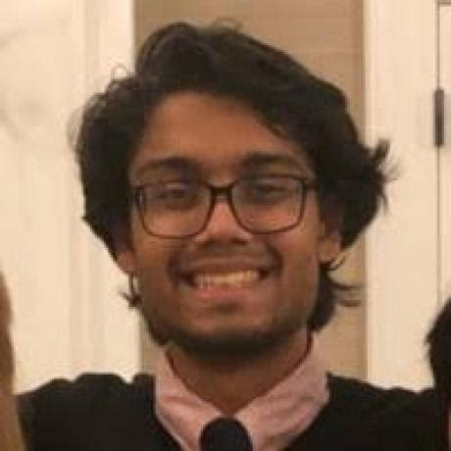
Martin (22)
“I really think corporations ought to take responsibility for emissions. I don’t feel a responsibility for the emissions generated when I fly with a commercial airline”
Insight
Some folks believe corporations should bear responsibility for emissions generated by transportation.
Need: A method to hold corporations responsible for their emissions.
Student
Stanford
Bike, Walk
30 min in-person interview

Slide 13

Jessica (29)
“Our employees drive to and from a nearby ski resort to pick up and drop off guests every day. They drive around 200 miles per day.”
Insight
This corporation spends a significant amount of resources transporting customers to and from their property.
Need: Demonstrate commitment towards sustainability to guests.
Works at Eco Resorts, Inc
Moran, WY
Trucks, Snowmobiles, Horses
30 min FaceTime interview
Notes:
Eco Resorts LLC is a hospitality company (hotels and amenities) with properties adjacent or inside National Parks
“Extreme” user because they (1) operate a large quantity and variety of gasoline vehicles and none of them can be electric any time soon (2) contract with the National Parks service, and NPS evaluates contract bidders on environmental friendliness

Slide 14
Analysis of Findings

Slide 15
“Being in a city like SF, it’s very nice to be able to do everything by myself, with my own power.”
“Metrics would make me more aware of my habits and their impact from an emission standpoint.”
I would be more motivated to do better with an awareness of my emission metrics.
“I would care more about my personal carbon footprint if corporations cared more and did more.”
I want to make an impact but I worry about how little it will amount to compared to that of corporations.
I want to be able to get around anywhere without the use of a car, not just in SF.
SAYS
THINKS
James
DOES
FEELS
Hesitated with a long pause when thinking about his own personal carbon footprint.
Conflicted for wanting to do all that he can while knowing that individual impact is not as meaningful.
Takes the shuttle with other employees to get to work for the most part.
Empowered to be able to get around in SF via walking or biking without needing a car.
Frequently compares his day-to-day living experience in SF versus Texas.
Unsure about what more to do in terms of reducing carbon or how to even do that.

Slide 16
Best experience is 280 b/c it is scenic, open, not dodging cars
Sustainability is important.
“Our culture doesn’t really acknowledge carbon usage.”
Unaware of what to do about carbon usage.
“I do a lot of little things to be more sustainable, like turning off the lights”
Spends a lot of money on gas.
SAYS
THINKS
Mike
DOES
FEELS
Pays for the cheaper flight option, ambivalent of the carbon.
Observant towards certain carbon effects.
Donates via corporate matching.
Sad that society doesn’t do enough.
LIves close to the highway in SF.
Considerate about the environmental impacts.

Slide 17
Tensions, Contradictions, Surprises
Tensions
People are aware of tools such as the Google Flights carbon emissions calculator but do not alter decision making based on it.
Contradictions
People want to do more from an individual standpoint despite knowing that their impact is much lower than that of large corporations.
People care about their carbon footprint but drive poor fuel economy gasoline cars.
Surprises
People are cognizant of small habits that help them live a more environmentally sustainable life.
People that reverse commute between SF and Palo Alto do not carpool.

Slide 18
Inferences, Conclusions, Questions
Inferences
Understanding carbon emissions doesn’t make sense in absolute terms.
Conclusions
There is both a individual and corporate desire to track emissions stemming from transportation.
Questions
What might make people more aware of the carbon usage of their commutes?
What type of tool would one use to track their carbon usage?

Slide 19
Summary
Through all of this we learned that…
Observing carbon emissions and footprint in a relative way are important.
Companies are more conscious of their carbon footprints and willing to spend to reduce it.
Young people maintain environmentally sustainable habits.
Economic decision making for individuals is not swayed by social cost of carbon.

Slide 20
Full Empathy Maps

Slide 21
“I used to think that sustainability was pretty much impossible because of how useful cars are.”
“I think a lot of environmental problems come from everyone commuting everywhere.”
“Being in a city like SF, it’s very nice to be able to do everything by myself, with my own power.”
“Living in SF, I realized I hate driving. The city was made for biking and walking around in.”
It is unfortunate that sustainability is overlooked a lot in America.
I am generally conscious about my environmental impact but don’t know it in detail.
I want to be more aware of the emission metrics of my daily actions in more detail — e.g. driving, flying, etc.
I would be more motivated to do better with an awareness of my emission metrics.
“I’m trying to lower how often I drive, to take as few trips as possible, and to carpool as often as possible.”
“Metrics would make me more aware of my habits and their impact from an emission standpoint.”
“I don’t go into the office if there’s nothing I need to do there, like in the lab for example.”
“I used to live in Texas, where there’s basically no such thing as public transportation.”
I want to make an impact but I worry about how little it will amount to compared to that of corporations.
I actively try to minimize my individual harm.
I want companies and corporations to care more and do more.
I appreciate that the company I work for, Apple, is actively working to reduce carbon.
“I would care more about my personal carbon footprint if corporations cared more and did more.”
“It really seems like most of our cities were built around the assumption that everyone can drive everywhere.”
“Apple corporate is currently carbon neutral, and I think our outsourced factories are aiming to be by 2030.”
SAYS
THINKS
I want to be able to get around anywhere without the use of a car, not just in SF.
Where you live and where you work are very important factors in individual environmental impact.
James
Frequently walks and bikes to get around in SF.
Takes the shuttle with other employees to get to work for the most part.
Stays home and works virtually when there is no need to go into the office.
Empowered to be able to get around in SF via walking or biking without needing a car.
More optimistic than before about impact of individual contribution now that he drives less.
Sad to know that individual impact to sustainability is far outweighed by that of corporations.
DOES
FEELS
Actively trying to lower how often he drives his car.
Hesitated with a long pause when thinking about his own personal carbon footprint.
Carpools with people whenever he can.
Checks the carbon dioxide emission metric when buying flights on Google.
Not as motivated to contribute further due to lack of awareness on the emission cost of day-to-day things.
Guilty for not doing as much as possible to reduce carbon and for having driven so much in the past.
Embarrassed about his past lifestyle of driving everywhere in Texas.
Aversion towards the idea of living in a place where you need to drive to get anywhere.
Leaves his personal car at his office to not use it during the week.
Frequently compares his day-to-day living experience in SF versus Texas.
Gets work done during commute time in the shuttle.
Conflicted for wanting to do all that he can while knowing that individual impact is not as meaningful.
Unsure about what more to do in terms of reducing carbon or how to even do that.
Jealous of countries where infrastructure being designed around public transportation is commonplace.

Slide 22
“The commute sucks”
Chose to live in a part of city that makes the commute shorter
Best experience is 280 b/c it is scenic, open, not dodging cars
If incentive structure was aligned financially, he would care about carbon
Sustainability is important
Being actionable is important
Society isn’t structured to sway away from carbon usage
Spends a lot of money on gas
“I usually go for the cheaper option”
“Our culture doesn’t really acknowledge carbon usage”
“Carbon offsets are huge for corporations.”
“I don’t really care about the Google flights carbon usage”
Decision to think about carbon comes down to consumer
Traffic matters in his commute
Citibank had a great carbon neutrality program
Company does a lot of stuff for communities
“I hate weaving through traffic”
“I do a lot of little things to be more sustainable, like turning off the lights”
“I’m glad there’s dates for reaching carbon neutrality, but I don’t think anyone will meet them”
SAYS
THINKS
Unaware of what to do about carbon usage
Carbon offsets are a good way for corporations to make commitments
Corporate charitable matching is a great benefit
Mike
Work via Zoom 1-2 days a week.
Donates via corporate matching.
Spends a lot of money on gas.
Responsible enough for carbon usage
Sad that society doesn’t do enough
Ambivalent towards environmental costs of flying
DOES
FEELS
Keeps up to date with ESG policies for his portfolio companies.
LIves close to the highway in SF.
Drives a LOT.
Turns off the lights when he is not home.
Determined to shorten his commute.
Annoyed by the amount he has to drive.
Considerate about his environmental impacts.
Generous about his company’s matching policy
Pays for the cheaper flight option, ambivalent of the carbon.
Flies a lot for personal and professional reasons.
Watches his water usage.
Turns off the AC when is not home for extended periods of time.
Analytical about choosing where he lives.
Thoughtful about his gas consumption.
Observant towards certain carbon effects.
Worried about carbon effect on our environment.

Slide 23
“I work for Social Security at their Richmond offices”
“Instead of using my car to commute to work, I take the Amtrak (train)”
“It takes an hour and a half to get from Sacramento to Richmond”
“I think I would care more about sustainability if there were easier ways to contribute”
Believes that taking the train reduces his carbon footprint compared to driving
Does not think too much about sustainability in daily life
Does not think about sustainability related to transportation
Thinks he can contribute more to sustainability if there were easier/better ways to
“I have never heard of the term carbon offsets”
“There’s nothing at the Social Security office that relates to promoting sustainability”
“I’d rather take the train and relax than need to drive to Richmond everyday”
“I don’t think too much about sustainability, I just know it is good for the environment”
Thinks he himself does not make a big impact of sustainability efforts
Does not think about his carbon footprint on the daily
Thinks that taking the train is a better option compared to being stuck in traffic
Thinks that recycling at home is one of the main ways he contributes to sustainability
“I think that taking the train reduces my carbon footprint compared to driving everyday”
“I don’t know too much about what a carbon footprint is”
“I spend about 3 hours on the train each day”
SAYS
THINKS
Does not think recycling or separating trash is the only way
Does not know how much he impacts the environment with taking the train to work
Does not know that carbon offsets can be bought by companies
Ben
Takes the train to work
Lives in Sacramento and commutes to Richmond for work
Works for Social Security
Enjoys taking the train to work
Feels that he can definitely do more to contribute to sustainability
Does not enjoy paying too much for gas
DOES
FEELS
Does not care a great deal about sustainability, knows it is important
Does not know anything about carbon offsets
Likes taking the train because he can relax once on it
Does not like how the train can be delayed
Does not feel like he can contribute much to sustainability by himself
Feels like there are not easy ways to think about sustainability when it comes to commuting
Feels that commuting to work is something no one can avoid, so no one thinks about the impact of it
Feels like global warming is definitely becoming a more prominent issue
Spends $300/month on gas
Does not like that the train can be expensive when taken multiple times
Family recycles at home, does so at work as well
Separates trash as much as possible
Feels that having a better understanding of carbon offsets can help him act on it
Does not feel that taking the train and recycling is doing enough
Feels like he should do more himself to be more educated on sustainability issues
Feels open to learning more

Slide 24
“The National Parks are a public asset that bring us business”
“NPS and the USDA reward our sustainability efforts”
“I am proud to tell people that our corporation is a steward of the environment”
“Having hydroelectric power makes being sustainable much easier”
We need to preserve our National Parks and forests
The government is an important part of sustainability efforts
How can we save money on energy costs
How should we present our sustainability efforts so people are aware of and happy with them
“One of our employees commutes over 100 miles every day”
“Gas is expensive, even though we’re pulling it straight out of the ground here”
“It will be a long time before electric vehicles can deal with the cold here”
“Electric pickups are great for getting around the suburbs, but not for freezing, isolated sites”
It is valuable to quantify carbon emissions and other impacts on the environment
Eco Resorts will continue using gas vehicles for a long time
Being preemptive and prudent is essential to staying in business
Guests appreciate the efforts we make to lower our environmental impact
“Snowstorms can cause a lot of car accidents, especially with so many tourists on the road”
“We spend over $100k on car insurance a year”
“The cost of buying carbon offsets could be passed onto NPS/USDA”
SAYS
THINKS
Corporations bear a responsibility to the environment, but the Gov. should lead the charge
Electric vehicles are the future
Appliances on power grid are more reliable than gas appliances
Eco Resorts, LLC
Writes about sustainability in contract bids
Communicates with USDA and NPS about future sustainability goals and programs
Talks to guests about sustainability efforts on property
Encouraged by NPS and the USDA, as they both reward sustainability
Proud to tell people about the corporations sustainability efforts
Enabled to increase the sustainability of the corporation
DOES
FEELS
Replaces older, less energy efficient vehicles with new ones
Researches the impact of vehicle models on the environment
Researches the safety ratings of new cars before buying
Monitors drought conditions and how they might affect hydroelectric power supply
Confused about the cost of gasoline
Competitive about leveraging sustainability to win contracts
Excited about EV usage in less harsh conditions
Realistic about EV usage in cold temperatures and isolated areas
Pays for automobile insurance
Converts gas heaters to electric
Monitors the weather and how it could affect road conditions
Queries guests for feedback on their perception of resorts sustainability efforts
Troubled about car accidents and road conditions
Patriotic about the U.S.’s National Parks
Intrigued by the prospect of collaborating with NPS/USDA on carbon offsets
Concerned about the wellbeing of commuting employee

